Slide 1
Information security
Web security

Slide 2
How the Web Works
Part 1:
Backends and frontends
Part 2:
HTTP, Browsers and Sessions

Slide 3
Part 1: Frontends and backends
Any idea what is happening when you visit, for example, Flex?
What is the frontend vs. backend?
Why are we discussing this?
Usually there are backend vulnerabilities manipulated through a frontend
So it is important to understand how both are implemented

Slide 4
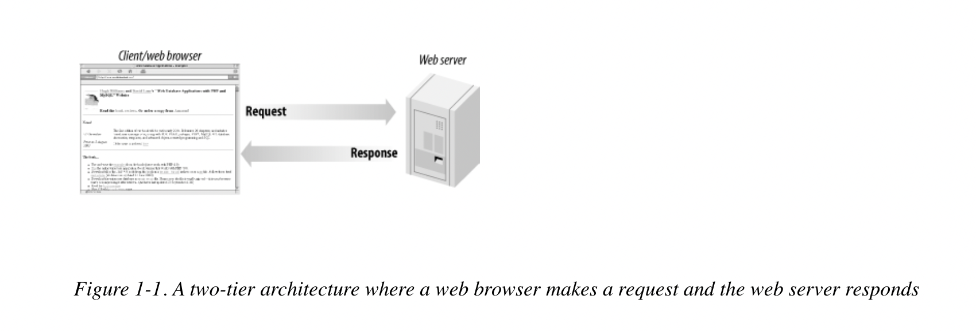
Two-tier model
Notes:
If a web server is issuing static resources only

Slide 5
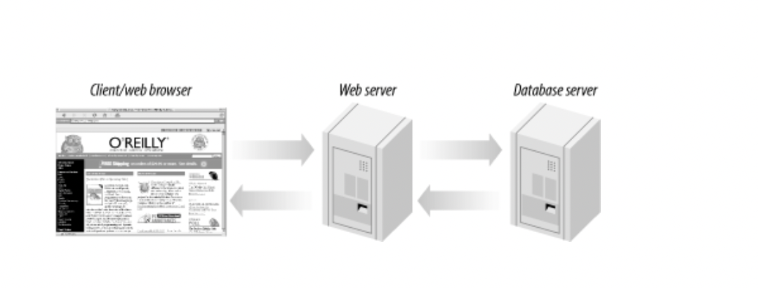
Three-tier model
A web server is not sophisticated storage software. Complicated operations on data, done by commercial sites and anyone else presenting lots of dynamic data, should be handled by a separate database.

Slide 6
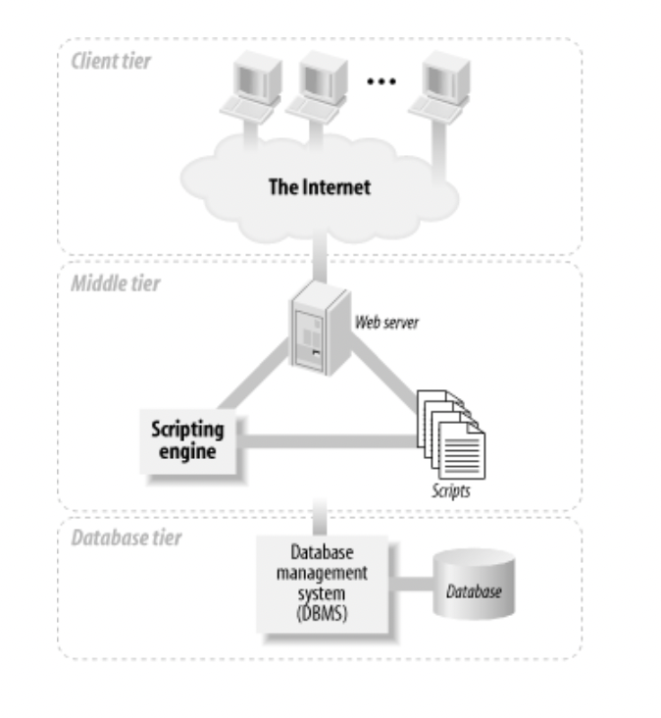
Three-tier model
At the base of an application is the database tier, consisting of the database management system that manages the data users create, delete, modify, and query. Built on top of the database tier is the middle tier , which contains most of the application logic that you develop. It also communicates data between the other tiers. On top is the client tier , usually web browser software that interacts with the application.

Slide 7
Three-tier model: implementation issues
The bottom two tiers can be co-located or located on separate machines
Discussion: what are the pros and cons of both?
We will implement these on a single machine, for simplicity.

Slide 8
http – the glue between the tiers
Where does HTTP come in?
The Web itself provides the protocols and network that connect the client and middle tiers of the application: it provides the connection between the web browser and the web server. HTTP is one component that binds together the three-tier architecture.

Slide 9
http, browsers and state
Web basics

Slide 10
HTTP: Hypertext transfer protocol
Web servers use the HyperText Transfer Protocol (HTTP) to transport web pages and their resources to user agents such as web browsers.
User agent generates requests for particular resources
Webservers expect these requests and return appropriate responses.
e.g. the requested resource (say a webpage), or an error code if it cannot be provided.

Slide 11
http requests
Method (verb): e.g. GET or POST data
URL: the location of the resource on the webserver
Headers: metadata, e.g. the encoding used to compress the content
Body: optional space for any contents to send to server.
Let’s see a sample HTTP request in the browser!

Slide 12
Get and post requests
GET: designed to “GET” objects (e.g. webpages, images etc.)
Response to get request contains the resource
POST: designed to “POST” data (e.g. when you fill a form).
Let’s have a look at this in Burpsuite.

Slide 13
HTTP Responses
Begin with a protocol, 3 digit status code, and a status message (e.g. HTTP/1.1 200 OK)
Status codes:
Starting with 2 indicate request responded to
Starting with 3 indicate redirection
Starting with 4 indicate client error (i.e. browser generated invalid request, e.g. 404 not found)
Starting with 5 indicate server error – valid request that server could not fulfill.
Headers: e.g. content encoding, type, cache control
Body contains requested resource – often HTML, or may be binary data

Slide 14
How browsers render webpages
When you request a webpage, it is returned as HTML text.
The rendering pipeline in a browser transforms it into what you visually see.
Try it yourself: send a request in Burpsuite and look at the response section; observe the HTML and then click “Render” to see how a browser would render the page.

Slide 15
The rendering pipeline: overview
Browser parses received HTML into a Document Object Model: an in-memory data structure containing the different elements of the page.
Each element of DOM has associated styling rules (often in a separate CSS file) – the font color, size, foreground and background color, positioning etc.
Next the browser draws all the elements on the screen.
Javascript included on the page is executed while constructing the DOM.

Slide 16
Document Object Model
Contains DOM “nodes” roughly corresponding to each HTML tag.
Each node is some element of the webpage, e.g. a form, a set of input fields (represented as nested node within the form’s DOM node), scripts etc.
This is called the DOM tree.
Some tags will reference external URL, e.g. <image> or <style> – browser makes additional HTTP request to these referenced URLs while loading the page.
Browsers fix apparently malformed HTML while parsing (e.g. missing braces, incorrect capitalization)
Notes:
<style> tag usually references some style sheet, possibly at external URL. That specifies how each element is to be styled, e.g. what should be color and font of all headings, what color should text become when user highlights etc.

Slide 17
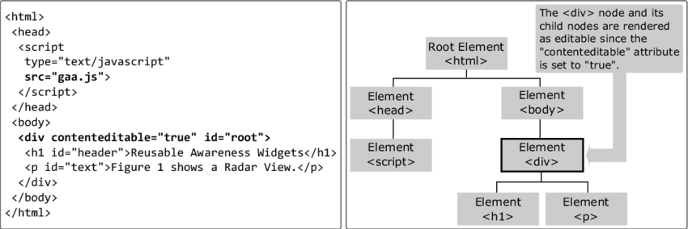
Constructing Dom tree

Slide 18
javascript
Javascript is a programming language that can be included inside HTML pages.
It is executed by browser’s Javascript engine whenever a <script> tag is parsed into a DOM node (unless a defer options is specified, in which case it does not execute until all the page is parsed).

Slide 19
Javascript in action
Open any website of your choice
Right click on any empty section of the page, and select Inspect
View the DOM of the page
Go to the Console tab
Write Javascript to manipulate the DOM. Try the scripts below:
Security implications?
window.alert(‘hello’);
var a =1
var b=10
window.alert(a+b)
document.cookie
Notes:
Because browsers obediently execute any javascript they come across, attackers can insert malicious javascript into a webpage. For example, by putting it into the comments section of a website (more on this when we study cross-site scripting attacks later). The attacker can get, for example, form data and have it sent to some malicious server.

Slide 20
Browser security model
Javascript code is strictly executed in a sandbox – it cannot:
Read memory outside of its sandbox, or access disk memory.
Start new processes
Call OS functions
However it can:
Read and manipulate DOM of the current webpage
Make HTTP requests
Reload the webpage or open a new webpage in response to a user action
Malicious Javascript can be injected into a legitimate webpage via cross-site scripting attacks and can steal information or load more malicious code.

Slide 21
What else does a browser do?
Resolve hostnames to IP addresses via DNS
Check certificates for establishing secure connections
Store and transmit cookies according to webservers’ instructions
Notes:
Rendering is just ONE job. Browsers do a lot more,=.

Slide 22
Behind-the-scenes: visiting www.amazon.com
User types www.amazon.com into browser
Browser resolves the domain name to IP
Checks the operating system’s DNS cache
If not found, requests ISP to check its own cache
If not found, ISP queries the authoritative DNS server
Browser initiates TCP handshake with server; server ack
Browser constructs HTTP GET request and sends to server
HTTPS established through TLS handshake (agree on cipher and exchange keys)
Server sends HTTP response containing HTML of homepage
Browser parses the request, constructing DOM (triggering many other HTTP requests in the process)
User navigates to log in page, enters credentials and submits form
Browser constructs POST request containing credentials and sends to server
Server authenticates user and establishes session using cookie
Server sends HTTP response containing Set-Cookie header
Browser stores cookie for prescribed time, and appends it to all future requests to amazon.com

Slide 23
STatefulness
HTTP by itself is stateless
Often statefulness is needed - i.e. keeping track of a user as it makes a series of requests
Why? e.g. shopping cart.
Session: entire conversation between user agent and server
How to keep track?
Notes:
First complete previous session: see a request, response and rendering in Burpsuite.
Later see a cookie in Burpsuite.

Slide 24
Session management
When user authenticates, server assigns a session ID (large random value)
Browser needs to transmit this with every request, so that the server can perform the requested action for that particular user.
Question: why don’t they just use the username?
Server typically stores session state along with session ID for each user.
Session state: everything it wants to remember about the user, e.g. list of pages visited
Two possible implementations: server-side sessions and client-side sessions.

Slide 25
Server vs. client side sessions
Server-side sessions:
Web server keeps session state in memory, session ID passed in every request.
When request arrives (with session ID), server retrieves associated state from its memory
If multiple servers, shared database or cache needed
Issue: inefficient for websites with large userbase
Client-side sessions:
All session state gets appended to the session ID
Client returns the entire session state every time.
Each incoming request now contains all information the web server needs
Issue: security, as malicious users can easily forge or manipulate the string.

Slide 26
Cookies
Most popular form of session ID
On first request, send a cookie back in the header of the response
Client includes this cookie in subsequent requests
In case of client-side session state, cookie includes a session ID plus all session information
Observe a cookie in Burpsuite.
Cookie security:
Either webserver can encrypt cookies before sending to user
Or digitally sign them (prevents forgery but does not ensure privacy).

Slide 27
Web security issues
Session hijacking
Compromising authentication
File upload vulnerabilities
Command injection/code execution
SQL Injections
Cross-site Request Forgery
Cross-site scripting
Privilege escalation and access policy compromise
Information leakage
HTTPS, SSL/TLS and HSTS
Third party code
XML attacks
DOS Attacks
…And many more.

Slide 28
Web security issues we will cover in this course
SQL Injection
Cross-site Scripting
CSRF
Privilege Escalation

Slide 29

With material from Dave Levin, Mike Hicks, Lujo Bauer
Department of Computer Science at the University of Maryland

Slide 30
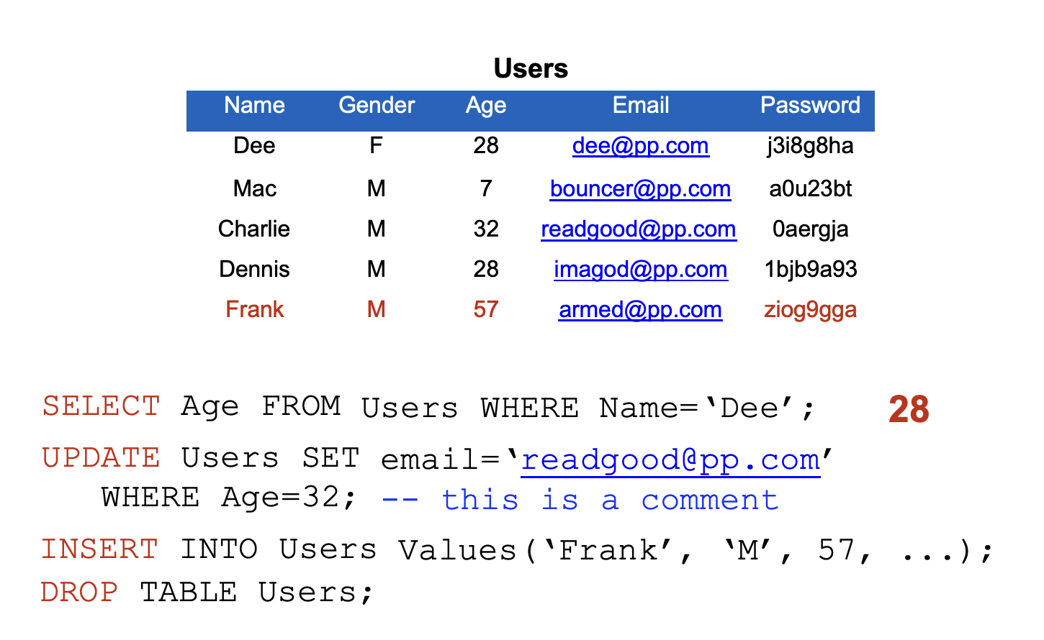
Structured query language (SQL)

Slide 31
SQL injection
Command injection oftentimes occurs when developers try to build SQL queries that use user-provided data
Known as SQL injection

Slide 32
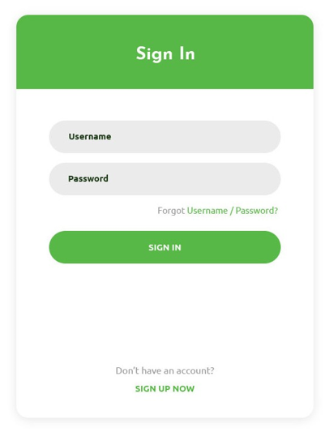
Ref: Stanford -CS155: Computer and Network Security

Slide 33
Insecure login checking
Sample PHP:
$login = $_POST['login'];
$sql = "SELECT id FROM users WHERE username = '$login'";
$rs = $db->executeQuery($sql); if $rs.count > 0 {
// success
}
Ref: Stanford -CS155: Computer and Network Security

Slide 34
Insecure login checking
Normal: ($_POST["login"] = "zakir")
$login = $_POST['login']; login = 'zakir'
$sql = "SELECT id FROM users WHERE username = '$login'"; sql = "SELECT id FROM users WHERE username = 'zakir'"
$rs = $db->executeQuery($sql); if $rs.count > 0 {
// success
}
Ref: Stanford -CS155: Computer and Network Security

Slide 35
Insecure login checking
Malicious: ($_POST["login"] = "zakir'")
$sql = "SELECT id FROM users WHERE username = '$login'"; SELECT id FROM users WHERE username = 'zakir''
$rs = $db->executeQuery($sql);
Ref: Stanford -CS155: Computer and Network Security

Slide 36
Insecure login checking
Malicious: ($_POST["login"] = "zakir'")
$sql = "SELECT id FROM users WHERE username = '$login'"; SELECT id FROM users WHERE username = 'zakir''
$rs = $db->executeQuery($sql);
// error occurs (syntax error)
Ref: Stanford -CS155: Computer and Network Security

Slide 37
Building an attack
Malicious: “' or 1=1 --" -- this is a comment in SQL
$login = $_POST[‘login']; login = 'zakir'
$sql = "SELECT id FROM users WHERE username = '$login'"; SELECT id FROM users WHERE username = '' or 1=1 --'
$rs = $db->executeQuery($sql); if $rs.count > 0 {
// success
}
Ref: Stanford -CS155: Computer and Network Security

Slide 38
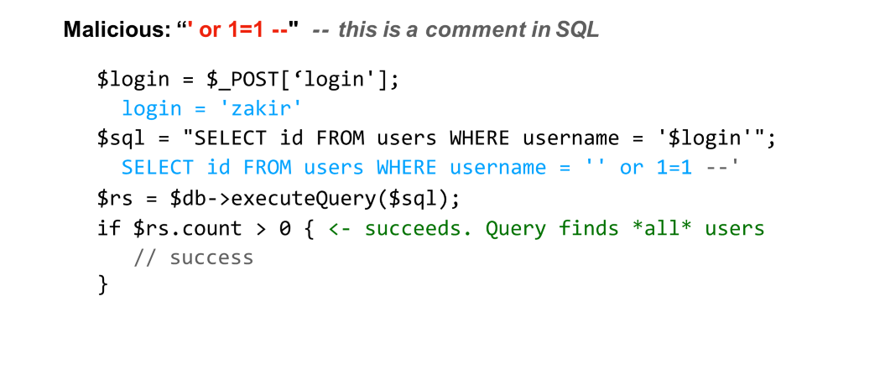
Building an attack
Ref: Stanford -CS155: Computer and Network Security

Slide 39
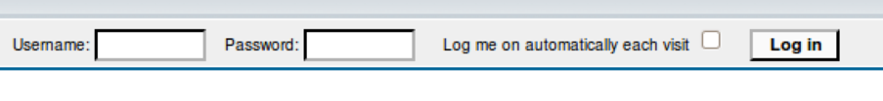
frank’ OR 1=1); --
$result
= mysql_query(“select
* from Users password=‘$pass’);”);
where(name=‘$user’ and
$result
= mysql_query(“select
* from
Users
where(name=‘frank’ OR 1=1); -- and password=‘whocares’);”);
-- Access (using null characters) ' OR '1'='1' %00 ' OR '1'='1' %16

Slide 40
frank’ OR 1=1); DROP TABLE Users; --
$result
= mysql_query(“select
* from Users password=‘$pass’);”);
where(name=‘$user’ and
Can chain together statements with semicolon: STATEMENT 1 ; STATEMENT 2

Slide 41
frank’ OR 1=1); DROP TABLE Users; --
$result = mysql_query(“select where(name=‘$user’ and
from Users password=‘$pass’);”)
where(name=‘frank’ OR 1=1); DROP TABLE Users;
-- and password=‘whocares’);”);
Can chain together statements with semicolon: STATEMENT 1 ; STATEMENT 2

Slide 42
Picking a Target
Some examples of dorks you can use to find sites vulnerable to a SQL injection attack include:
Google Dorking
inurl:index.php?id=
inurl:trainers.php?id=
inurl:buy.php?category=
inurl:article.php?ID=
For example, search results is http://www.udemy.com/index.php?catid=1. To find out if this site is vulnerable to SQL injection, simply add an apostrophe at the end of the URL like this:
http://www.udemy.com/index.php?catid=1’
If the page returns a SQL error, the website is vulnerable to SQL injection.

Slide 43
SQL injection attacks are prevalent
20
15
% of vulnerabilities that
are SQL injection
10
5
0
2002
2003
2004
2005
2006
2007
2008
2009
2010
2011
2012
2013
2014
2015
http://web.nvd.nist.gov/view/vuln/statistics

Slide 44
SQL injection countermeasures
•
Blacklisting: Delete the characters you don’t want
•
’
--
;
•
•
•
Downside: “Peter O’Connor”
•
You want these characters sometimes!
How do you know if/when the characters are bad?
•

Slide 45
SQL injection countermeasures
1. Whitelisting
•
Check that the user-provided input is in some set of values known to be safe
•
Integer within the right range
•
Given an invalid input, better to reject than to fix
•
“Fixes” may introduce vulnerabilities
Principle of fail-safe defaults
•

Slide 46
SQL injection countermeasures
2. Escape characters
•
Escape characters that could alter control
•
’ ‹ \’
; ‹ \;
- ‹ \-
\ ‹ \\
•
•
•
•
Hard by hand, but there are many libs & methods
•
magic_quotes_gpc = On mysql_real_escape_string()
•
•
Downside: Sometimes you want these in your SQL!

Slide 47
The underlying issue
$result = mysql_query(“select * from Users where(name=‘$user’ and password=‘$pass’);”);
This one string combines the code and the data
When the boundary between code and data blurs, we open ourselves up to vulnerabilities

Slide 48










The underlying issue
$result = mysql_query(“select * from Users where(name=‘$user’ and password=‘$pass’);”);
select / from / where
*
Users
and
=
=
name
$user
password
$pass

Slide 49



The underlying issue
$result = mysql_query(“select * from Users where(name=‘$user’ and password=‘$pass’);”);
select / from / where
*
Users
and
=
=
name
$user
password
$pass

Slide 50
SQL injection countermeasures
3. Prepared statements & bind variables
Key idea: Decouple the code and the data
$result = mysql_query(“select * from Users where(name=‘$user’ and password=‘$pass’);”);

Slide 51
Prepared Statements
A prepared statement is a feature used to execute the same (or similar) SQL statements repeatedly with high efficiency.
Prepared statements basically work like this:
Prepare: An SQL statement template is created and sent to the database. Certain values are left unspecified, called parameters (labeled "?"). Example: INSERT INTO MyGuests VALUES(?, ?, ?)
The database parses, compiles, and performs query optimization on the SQL statement template, and stores the result without executing it
Execute: At a later time, the application binds the values to the parameters, and the database executes the statement. The application may execute the statement as many times as it wants with different values
Source: https://www.w3schools.com/php/php_mysql_prepared_statements.asp

Slide 52
Prepared Statements
Compared to executing SQL statements directly, prepared statements have three main advantages:
Prepared statements reduce parsing time as the preparation on the query is done only once (although the statement is executed multiple times)
Bound parameters minimize bandwidth to the server as you need send only the parameters each time, and not the whole query
Prepared statements are very useful against SQL injections, because parameter values, which are transmitted later using a different protocol, need not be correctly escaped. If the original statement template is not derived from external input, SQL injection cannot occur.
Source: https://www.w3schools.com/php/php_mysql_prepared_statements.asp

Slide 53
SQL injection countermeasures
3. Prepared statements & bind variables
Key idea: Decouple the code and the data
$result = mysql_query(“select * from Users where(name=‘$user’ and password=‘$pass’);”);
$db = new
mysql(“localhost”,
“user”,
“pass”,
“DB”);
$statement
= $db->prepare(“select
* from
Users
where(name=?
and password=?);”);
$statement->bind_param(
$statement->execute();
$user, $pass);

Slide 54
SQL injection countermeasures
3. Prepared statements & bind variables
Key idea: Decouple the code and the data
$result = mysql_query(“select * from Users where(name=‘$user’ and password=‘$pass’);”);
$db = new
mysql(“localhost”,
“user”,
“pass”,
“DB”);
$statement
= $db->prepare(“select
* from Users
where(name=?
and password=?);”);
Bind variables
$statement->bind_param(
$statement->execute();
$user, $pass);

Slide 55
SQL injection countermeasures
3. Prepared statements & bind variables
Key idea: Decouple the code and the data
$result = mysql_query(“select * from Users where(name=‘$user’ and password=‘$pass’);”);
$db = new
mysql(“localhost”,
“user”,
“pass”,
“DB”);
$statement
= $db->prepare(“select
* from Users
where(name=?
and password=?);”);
Bind variables
$statement->bind_param(
$user, $pass);
$statement->execute();
Bind variables are typed

Slide 56
SQL injection countermeasures
3. Prepared statements & bind variables
Key idea: Decouple the code and the data
$result = mysql_query(“select * from Users where(name=‘$user’ and password=‘$pass’);”);
$db = new
mysql(“localhost”,
“user”,
“pass”,
“DB”);
$statement
= $db->prepare(“select
* from Users
where(name=? and password=?);”);
Bind variables
Decoupling lets us compile now, before binding the data
$statement->bind_param(“ss”, $user, $pass);
$statement->execute();
Bind variables are typed

Slide 57
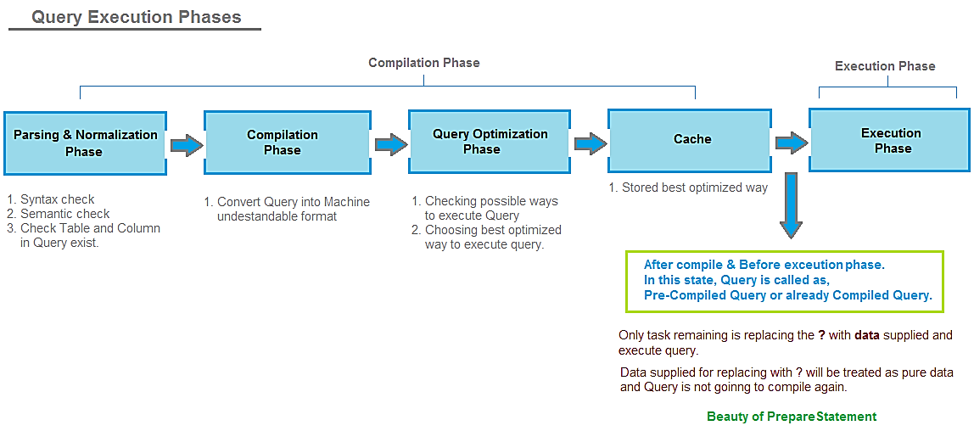
Prepared statement execution phases
$statement = $db->prepare(“select * from Users where(name=? and password=?);”);
https://javabypatel.blogspot.in/2015/09/how-prepared-statement-in-java-prevents-sql-injection.html
Notes:
https://javabypatel.blogspot.in/2015/09/how-prepared-statement-in-java-prevents-sql-injection.html

Slide 58
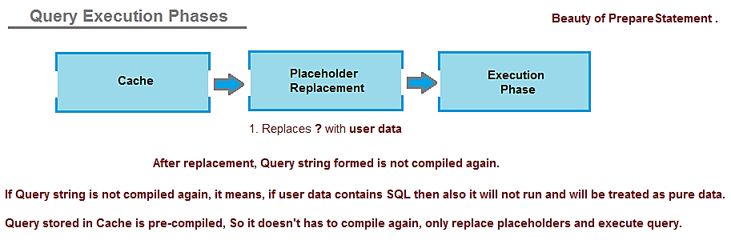
Prepared statement execution phases
$statement = $db->prepare(“select * from Users where(name=? and password=?);”);
https://javabypatel.blogspot.in/2015/09/how-prepared-statement-in-java-prevents-sql-injection.html
Notes:
https://javabypatel.blogspot.in/2015/09/how-prepared-statement-in-java-prevents-sql-injection.html

Slide 59
Prepared statement execution phases
$statement = $db->prepare(“select * from Users where(name=? and password=?);”);
(Remember, after place holders are replaced with user data, final query is not compiled/interpreted again and SQL Server engine treats user data as pure data and not a SQL that needs to be parsed or compiled again and that is beauty of PreparedStatement.)

Slide 60
Mitigating the impact
•
Limit privileges
•
Can limit commands and/or tables a user can access
Allow SELECT queries on Orders_Table but not on Creditcards_Table
Follow the principle of least privilege Incomplete fix, but helpful
-
•
•
•
Encrypt sensitive data stored in the database
•
May not need to encrypt Orders_Table
But certainly encrypt Creditcards_Table.cc_numbers
•

Slide 61
Acknowledgement
Some of the content of this lecture is taken from the following sources:
https://www.oreilly.com/library/view/web-database-applications/0596005431/ch01.html
Book: Web Security for Developers Real Threats, Practical Defense by Malcolm McDonald

